Slide 1
California Phenology TCN
Capturing California’s flowers: Using digital images to investigate phenological change in a biodiversity hotspot
Photo: Matt Ritter

Slide 2
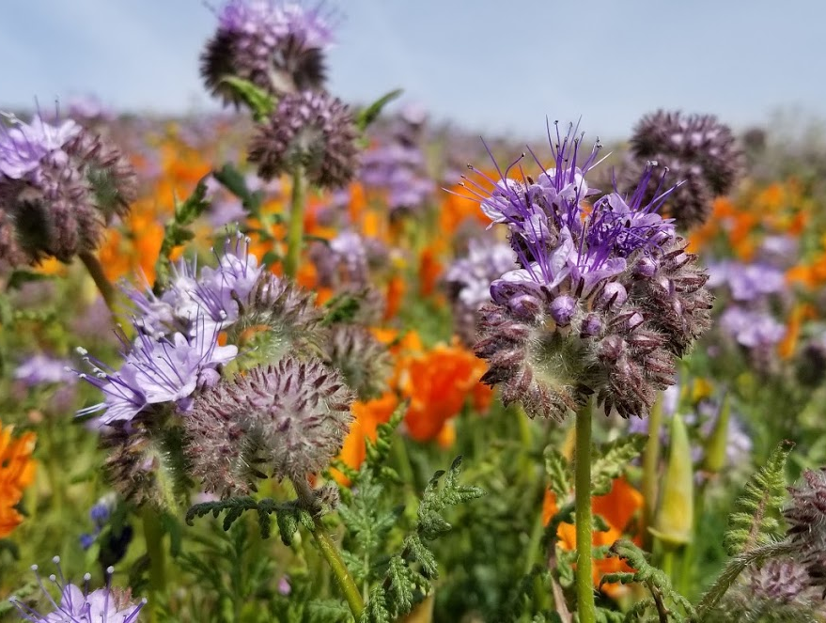
California Biodiversity
Introduction
Photo: Katie Pearson
Notes:
California is home to a wealth of fascinating and beautiful biodiversity, especially with regard to plants.

Slide 3
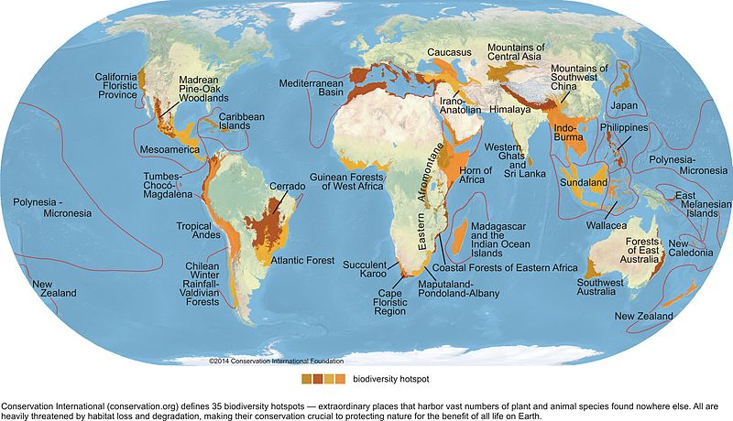
California Biodiversity
Introduction
Conservation International
Notes:
The California Floristic Province, stretching from southern Oregon to northern Baja California, is even known as one of the world’s biodiversity hotspots, with over 2000 plant species endemic to—or only found in—this region.

Slide 4
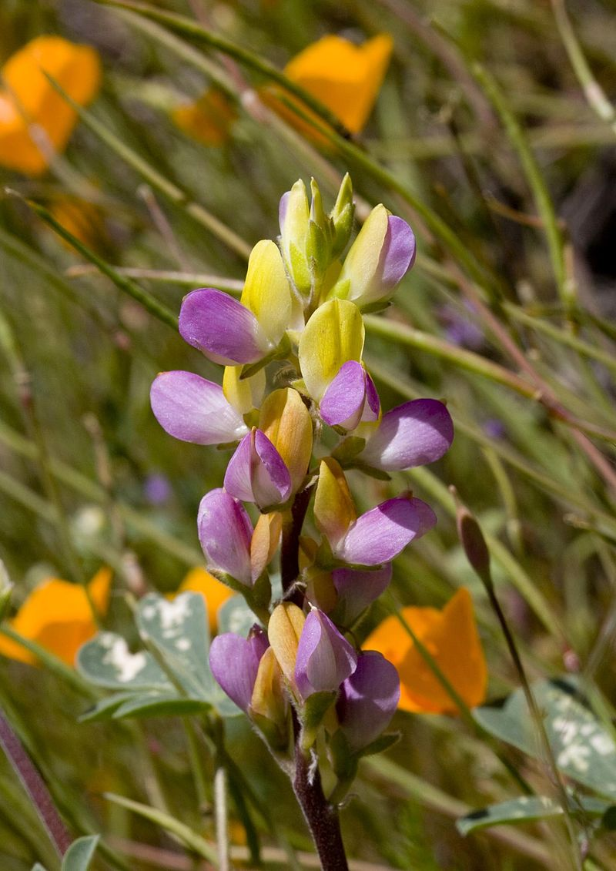
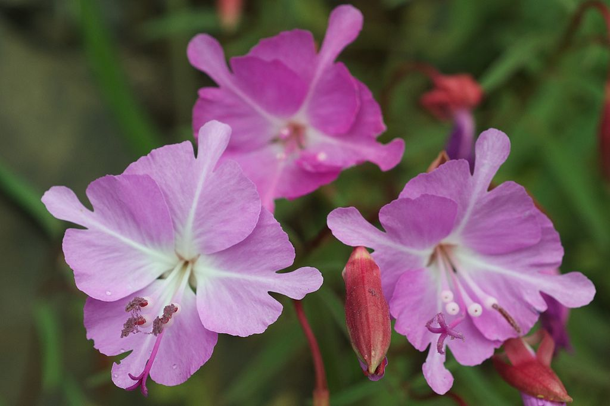
California Biodiversity
Introduction
40%
Endemic
Clarkia breweri, photo: Eric in SF
Lupinus stiversii, photo: Velo Steve
Notes:
40% of the plant species in California are endemic

Slide 5
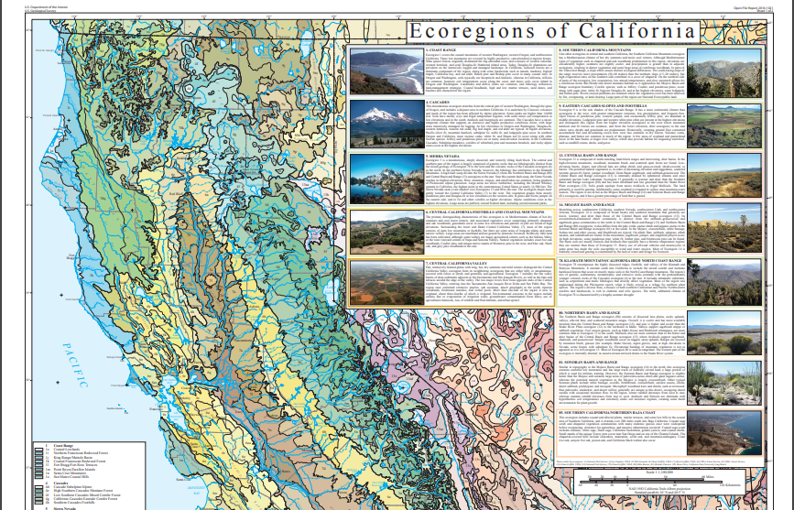
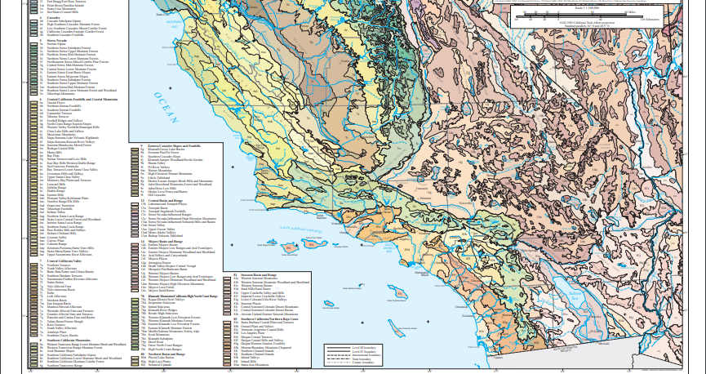
Introduction
Notes:
The wide range of latitudes, altitudes, and ecoregions in the region leads to...

Slide 6
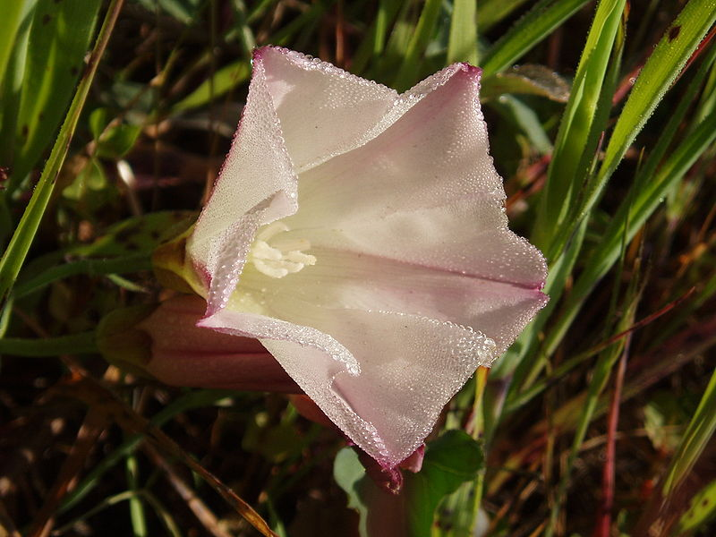
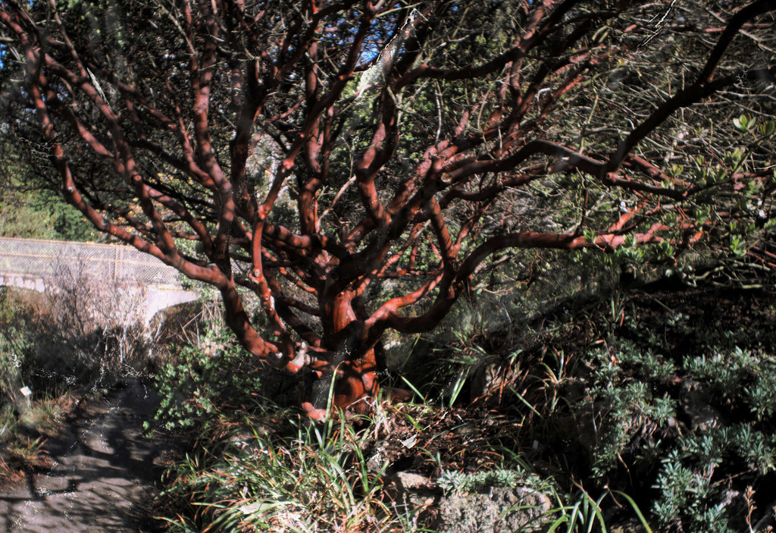
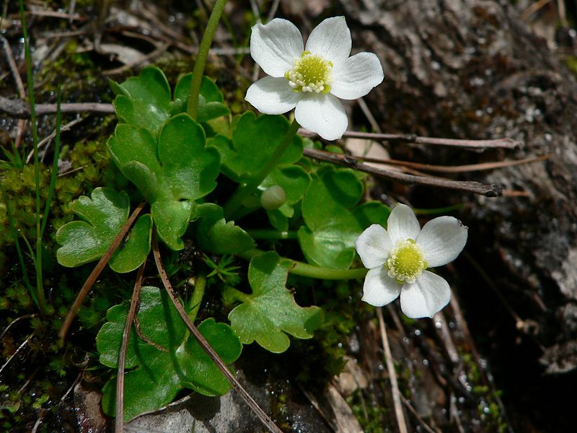
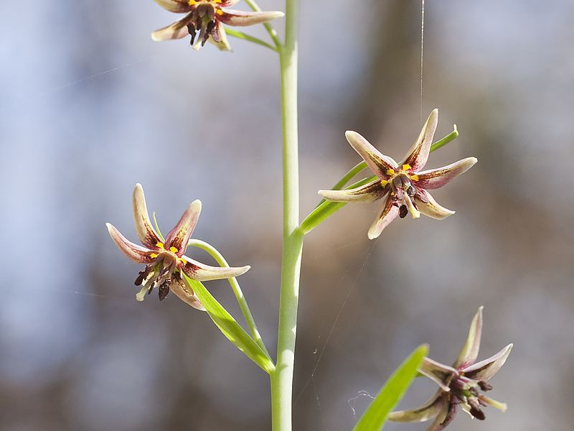
Introduction
Calystegia purpurata, photo: Tom Hilton
Arctostaphylos pallida, photo: John Rusk
Kumlienia hystricula, photo: Walter Siegmund
Fritillaria brandegeei, photo: John Game
Notes:
...a wild diversity of plant taxa with different life forms, characteristics, and strategies for survival in often inhospitable conditions.

Slide 7
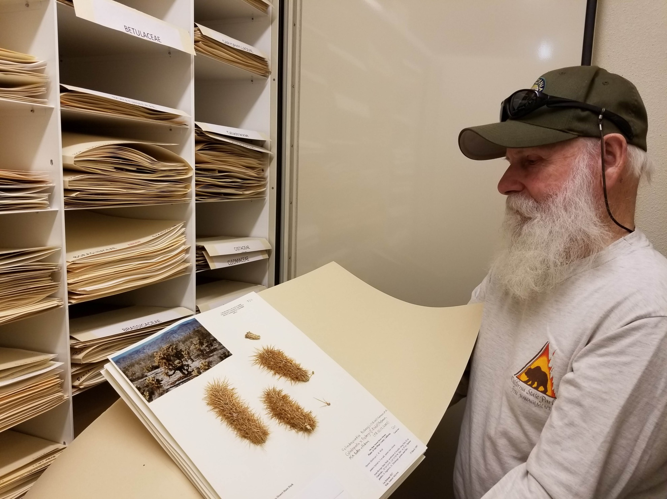
Introduction
California Dept. of Parks and Recreation, Colorado Desert District
Notes:
Plant diversity is cataloged in herbaria: collections of dried, pressed plant specimens.

Slide 8
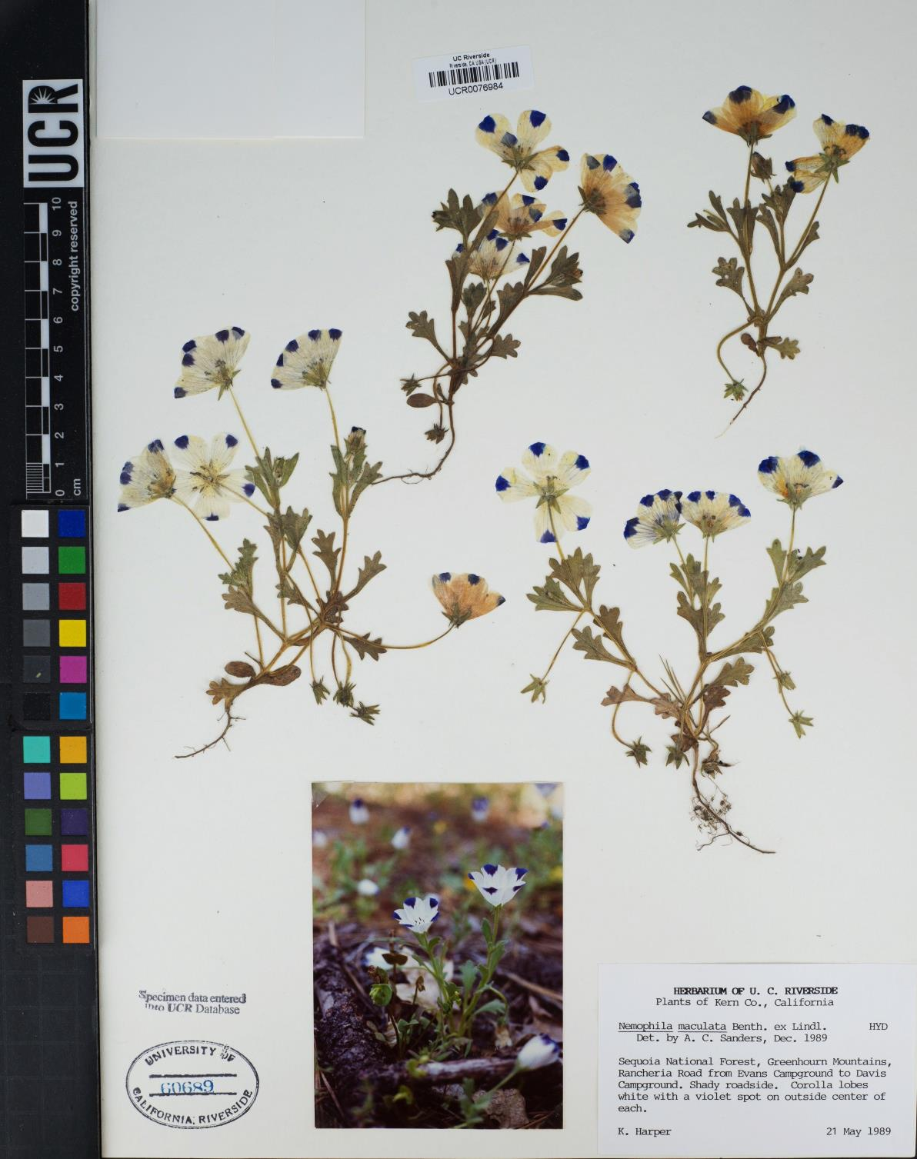
Introduction
Notes:
Plant specimens in herbaria are carefully collected and preserved to retain important features of the plant, and important data about the plant, such as the plant’s species, where and when it was collected, and who collected it, are recorded on a detailed label.

Slide 9
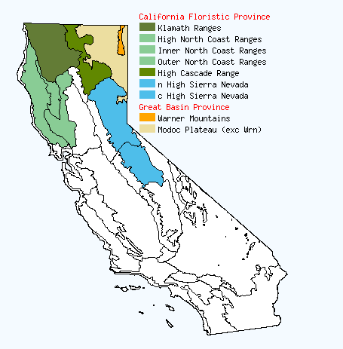
Introduction
Specimens of Ceanothus prostratus
Notes:
Herbarium specimens are vital sources of data on plant distributions, diversity, ecology, and evolution. They provide the baseline for our understanding of where and when plants occur.

Slide 10
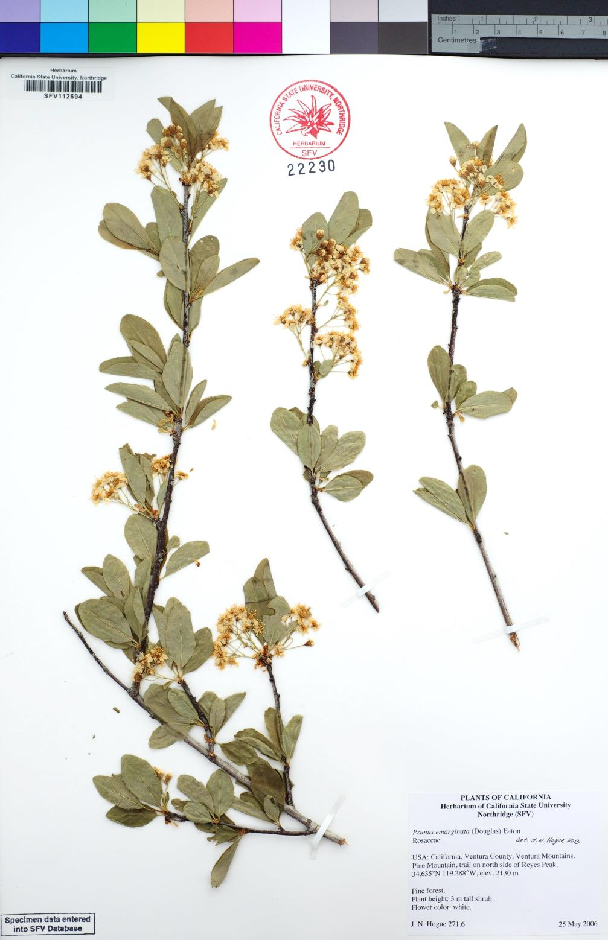
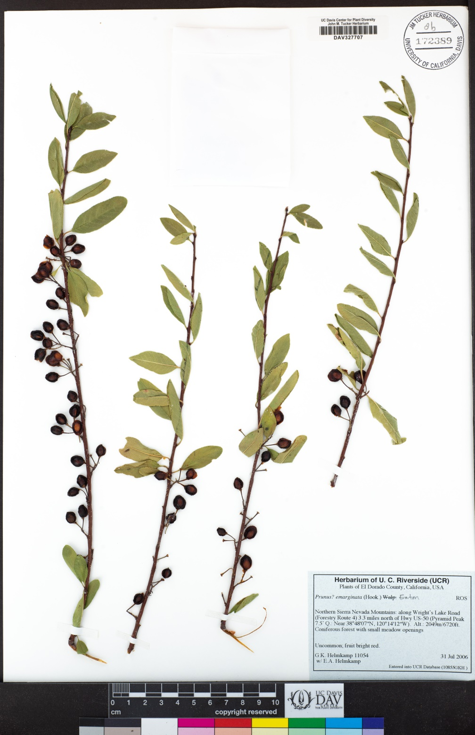
Introduction
Notes:
Herbarium specimens can also provide information about plant phenology: the timing of life history events such as growth and reproduction. The specimen on the left provides us a snapshot of a flowering event, while the specimen on the right provides a snapshot of a fruiting event.

Slide 11
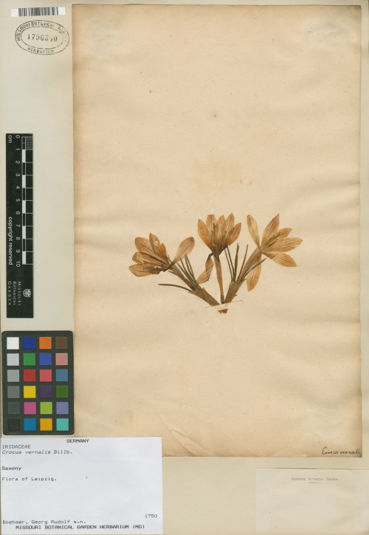
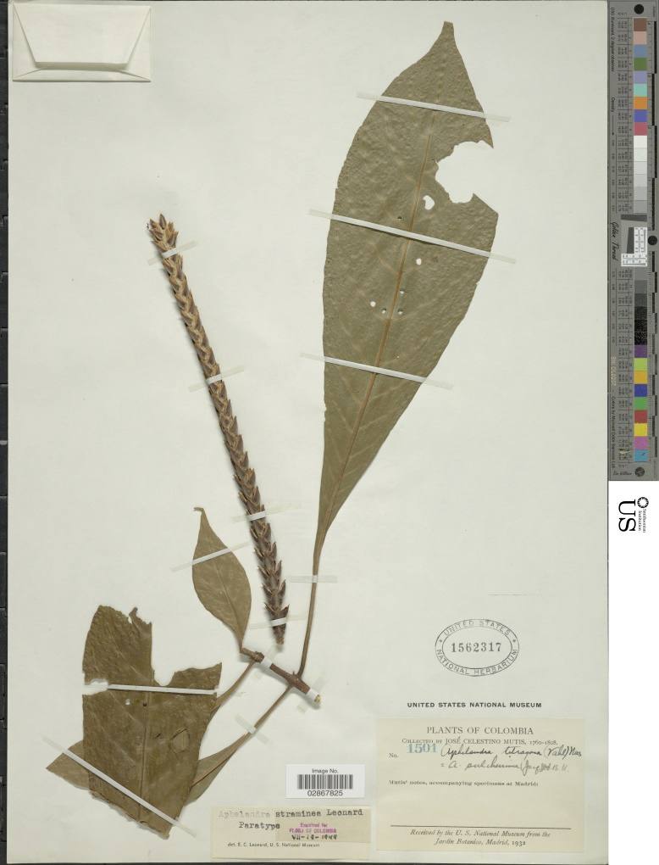
Introduction
Notes:
Herbarium specimens have been collected for hundreds of years and across the globe, which means they offer rich temporal depth and taxonomic and geographic diversity. However, this also means that specimen data were collected before the advent of computers and digital recordkeeping. As a result, much of the valuable data that specimens offer is not easy to access or analyze.

Slide 12
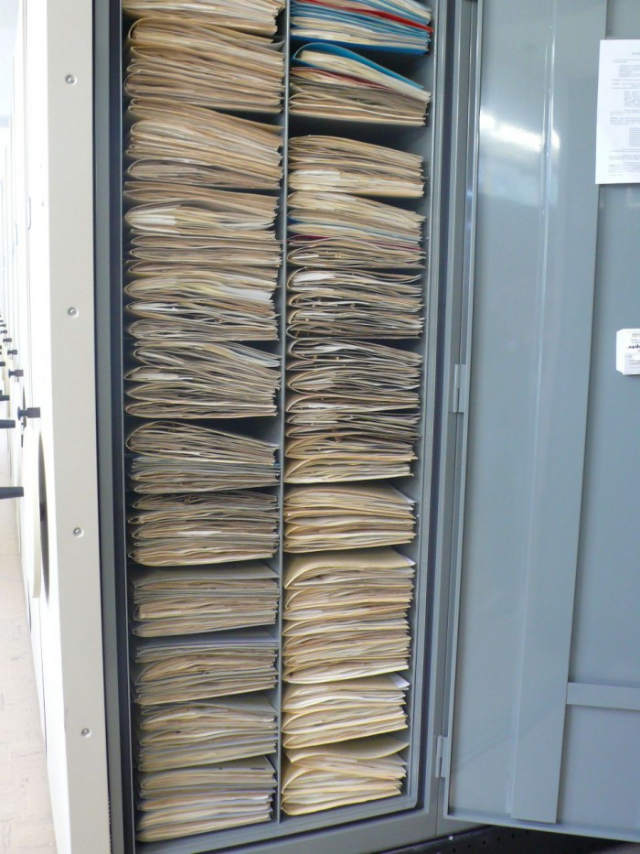
Digitization
Introduction
Notes:
To make these data usable for research and other uses, herbarium specimens must be digitized: the analog data are converted into digital form by creating images and digital records.

Slide 13
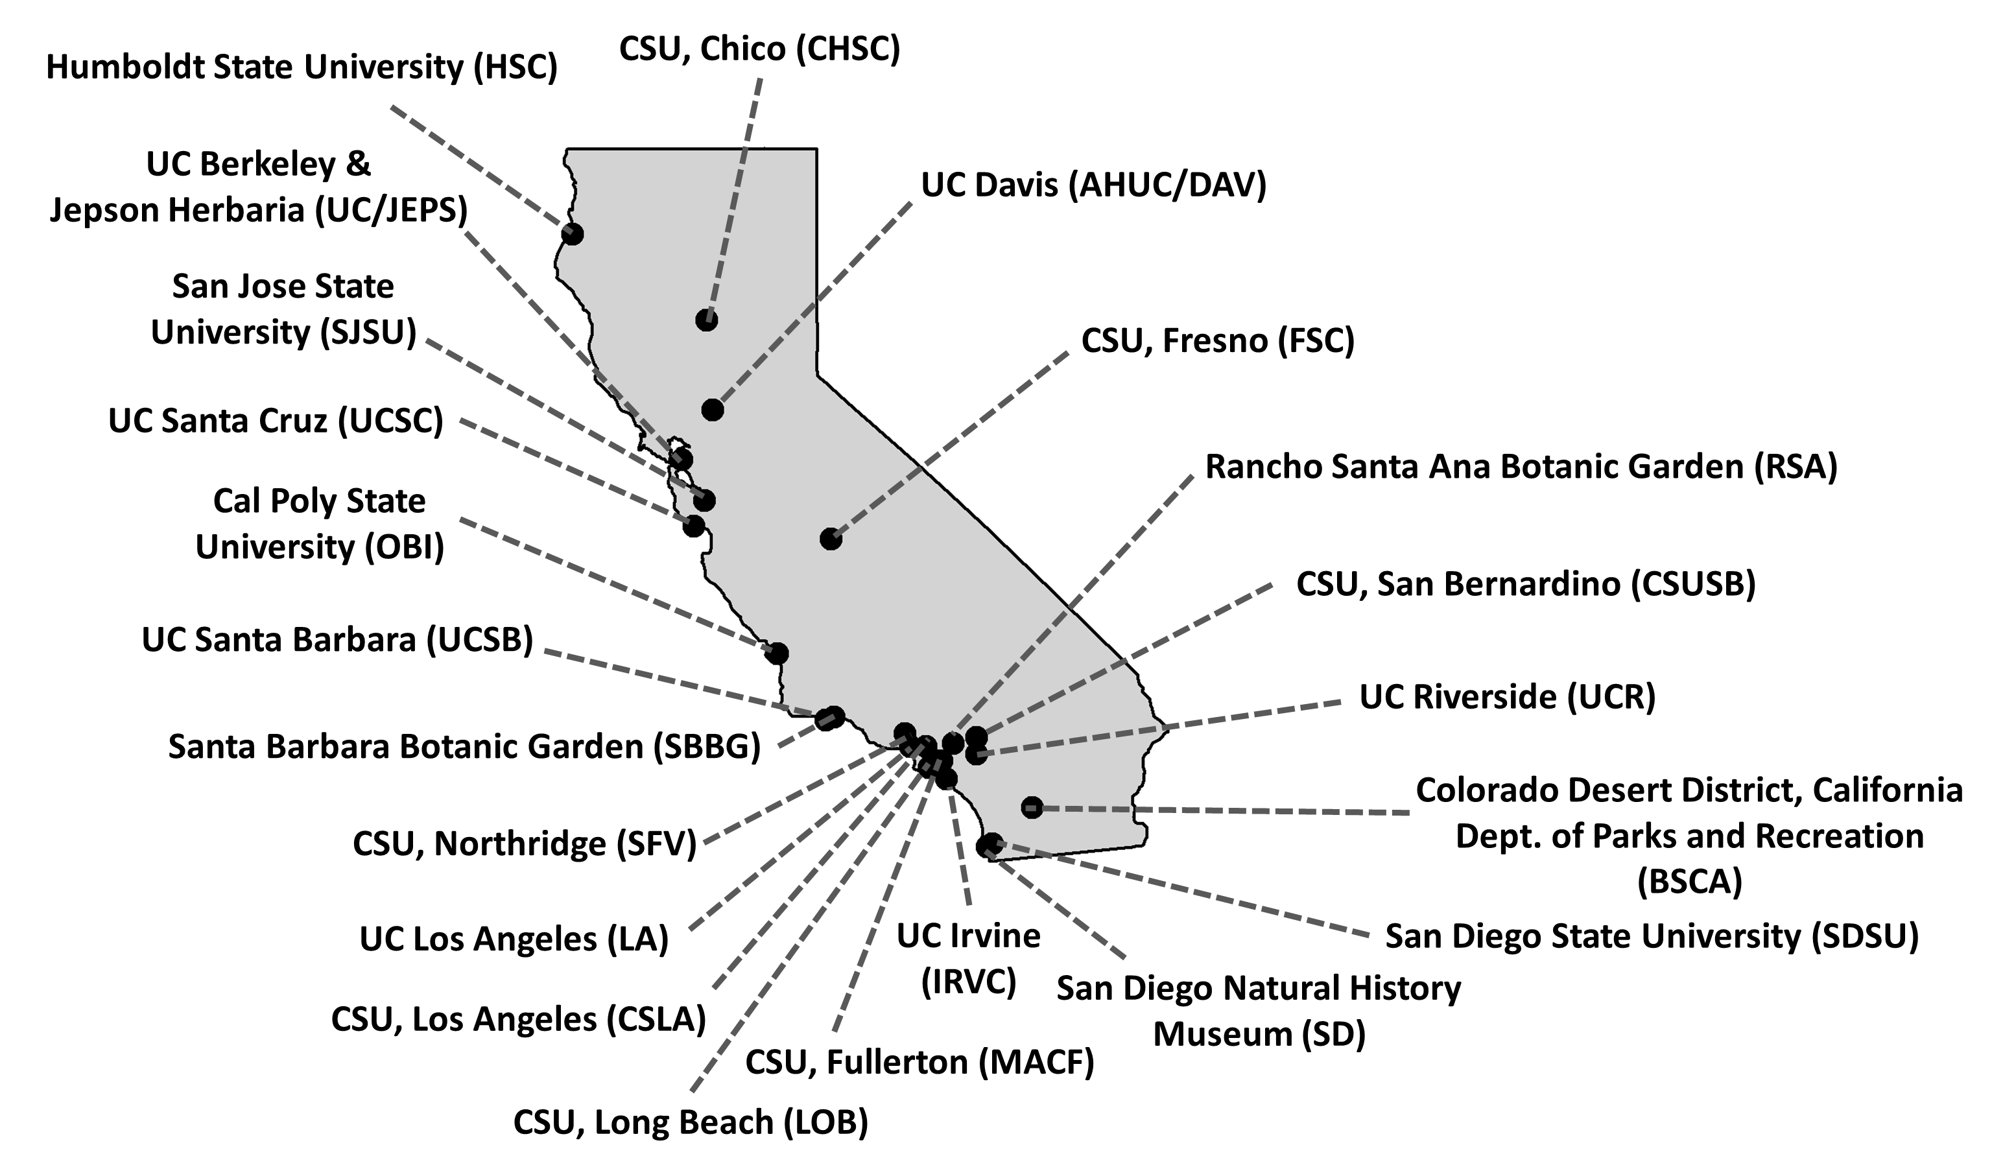
TCN = Thematic Collections Network
Introduction
Notes:
This is where the California Phenology Network comes in. The California Phenology Thematic Collections Network (or CAP TCN) is a collaborative project of 22 California institutions, each with its own herbarium.

Slide 14
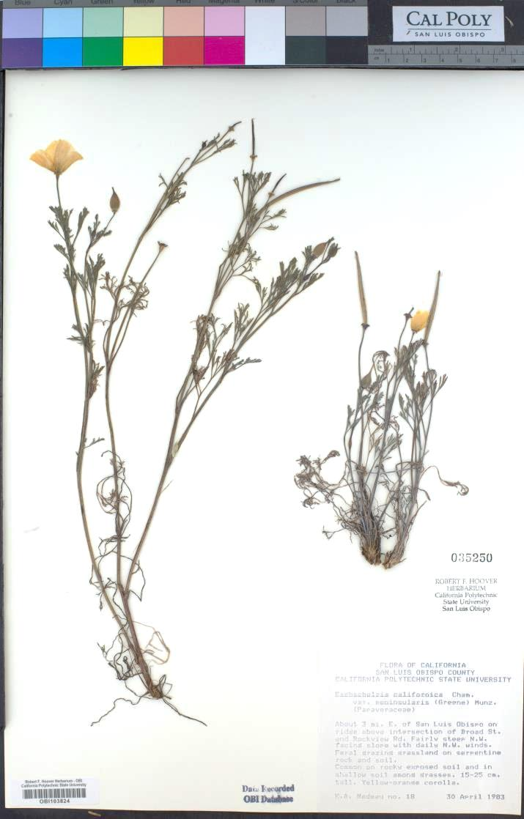
CAP TCN
Introduction
904,200 specimens
Image
Transcribe label
Georeference
Score phenology
Notes:
The California Phenology TCN was funded by the National Science Foundation to image nearly 1 million specimens held in the 22 California herbaria. From these pictures, we will be able to transcribe the label data of these specimens—recording the who, what, where, and when of each specimen. The data we transcribe from the label will then allow us to georeference each specimen, or record the estimated latitude and longitude where the plant was collected. These coordinates are very important to enable future research. Lastly, we will score the phenology of each specimen: recording whether each specimen is, for example, flowering or fruiting.

Slide 15
Targeted taxa
Introduction
58%
22 target families
Oldest records
Most diverse families
Most endemic and threatened families
250 additional taxa
Native species
67%
Endemic species
Notes:
Even 1.8 million dollars isn’t enough to digitize all specimens in every collection. For this reason, the CAP TCN is targeting specimens from 22 plant families that represent our oldest specimens, most diverse families, and families with the most endemic and threatened taxa in California. We are also including 250 additional taxa that are tracked by the National Phenology Network, a project that engages citizen scientists to gather observational data on phenology.

Slide 16
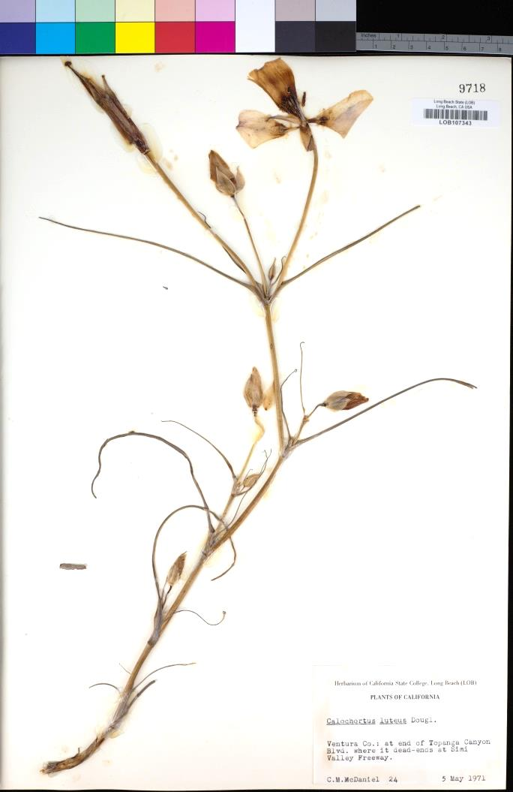
How do we digitize 1 MILLION specimens?
Implementation

Slide 17
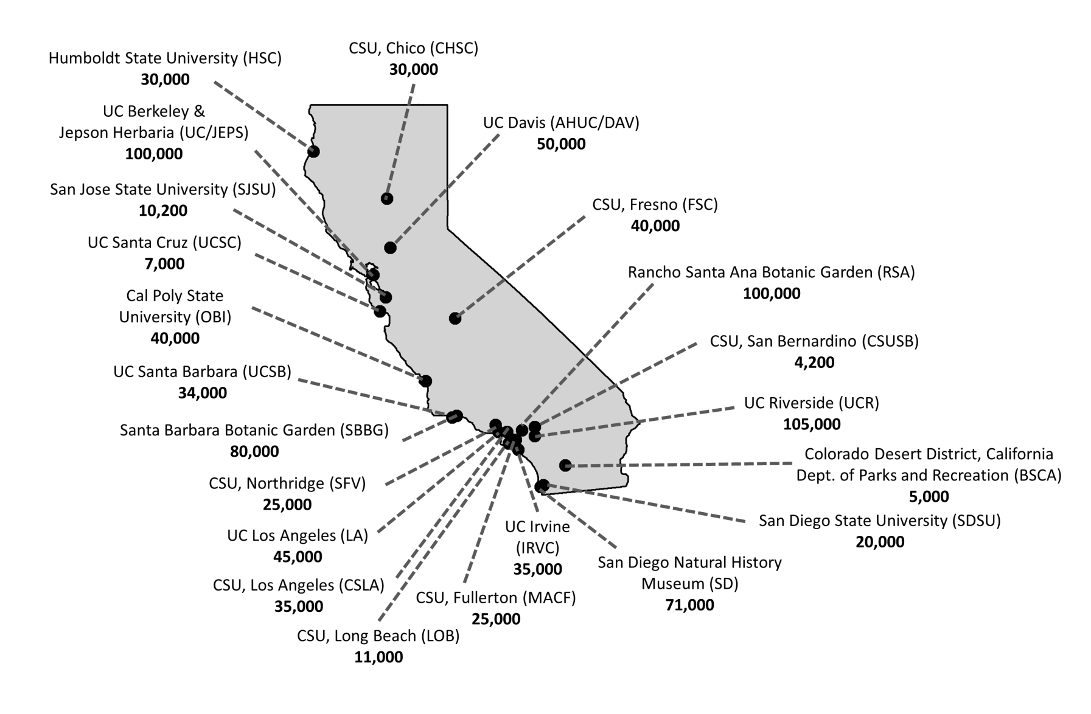
Teamwork!
Implementation
Yost et al. Madroño. In press
Notes:
Each institution aims to digitize a certain number of specimens from the target taxa.

Slide 18
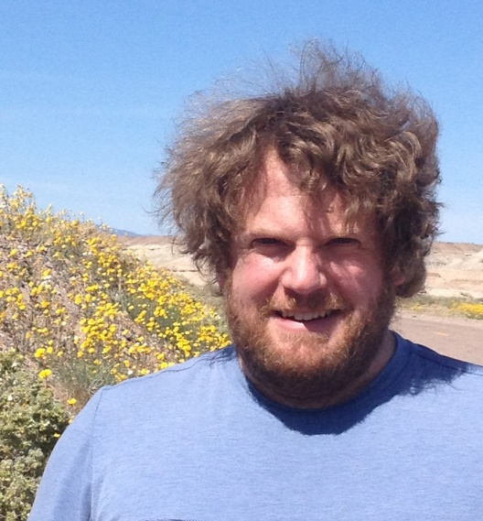
CAP TCN: Project Management Team
Implementation
Katie Pearson
Project manager
Cal Poly
Jason Alexander
Data manager
UC Berkeley
Ed Gilbert
Database developer
Jenn Yost
Lead PI
Cal Poly
kdpearso@calpoly.edu
Notes:
The project management team developed workflows, protocols, and equipment recommendations; holds monthly progress meetings; and helps each institution along the way.

Slide 19
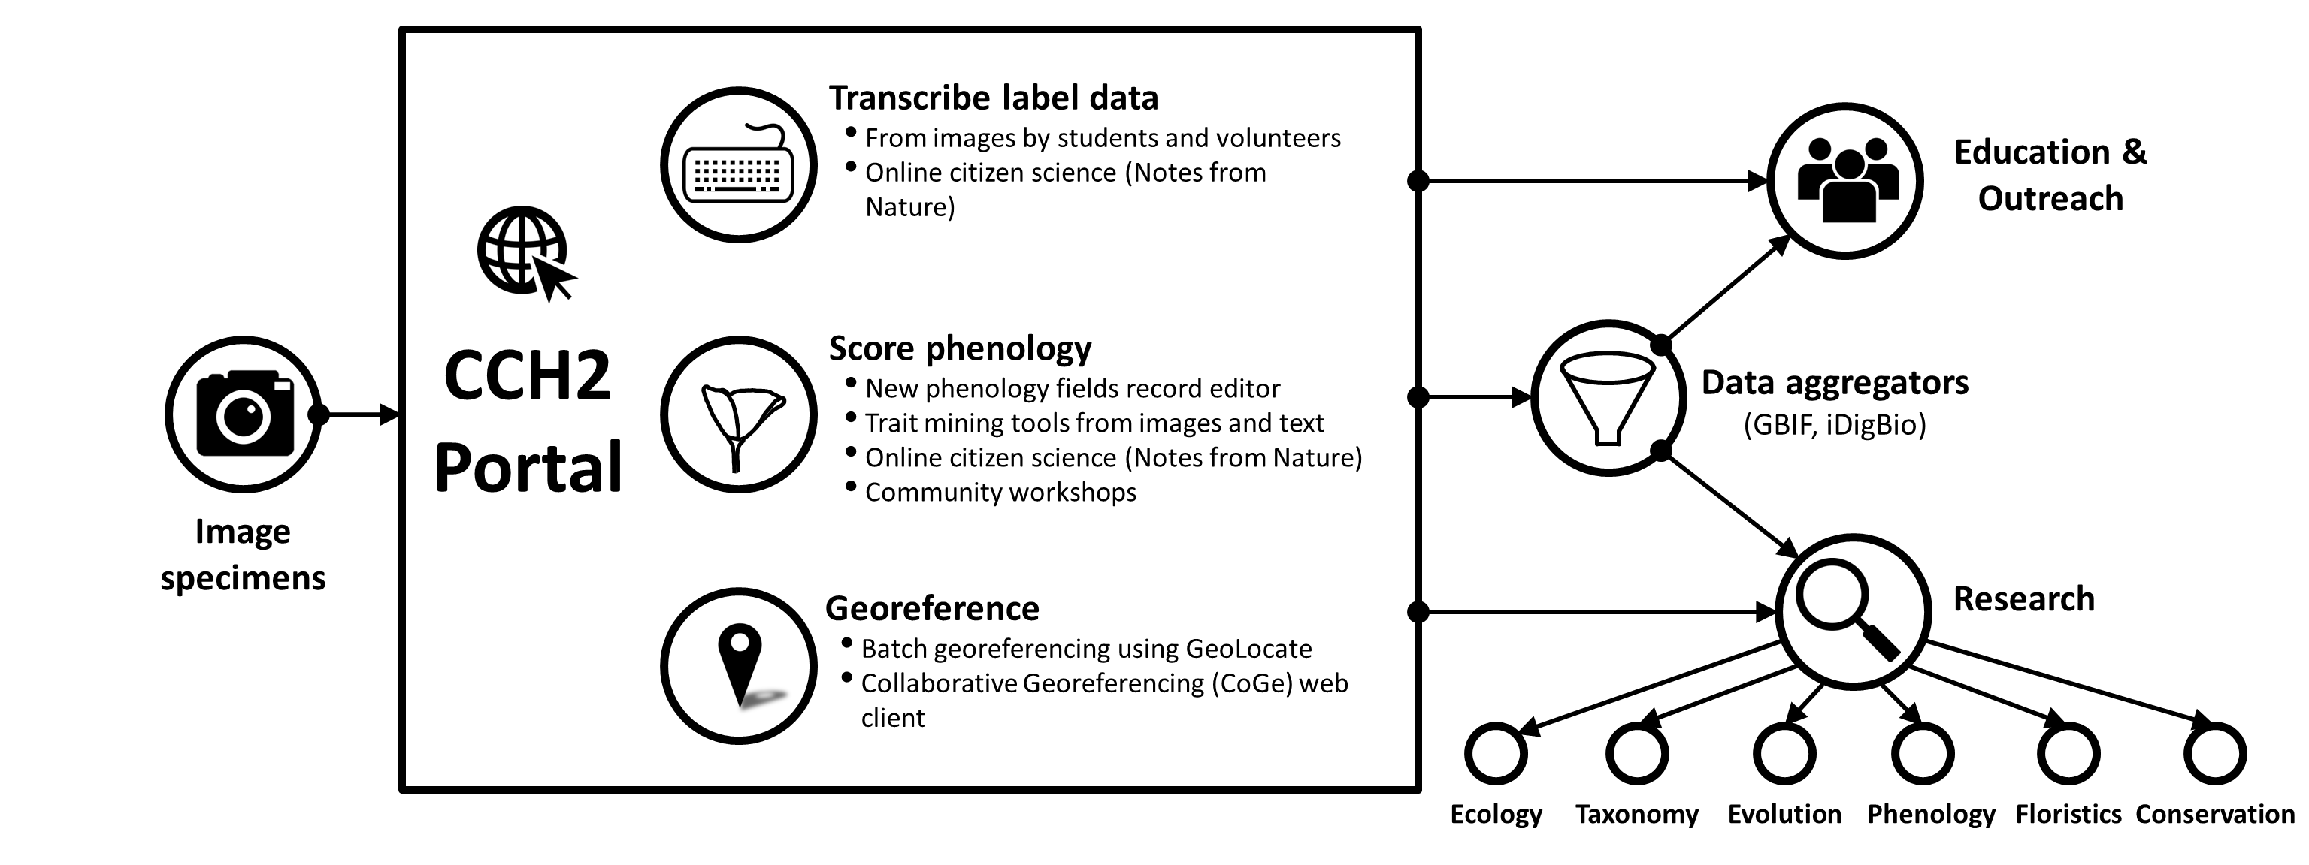
Implementation
Yost et al. Madroño. In press
Notes:
The first step is just to image specimens. Once these high-resolution photographs are taken of each specimen, data can be transcribed from specimen labels, the phenology (flowering or fruiting status) of the specimen can be scored, and the locality data can be used to georeference—or produce GPS coordinates for—each specimen. These data are created in the online data portal and database, CCH2. These data are publicly accessible for research, education and outreach in a number of different fields and disciplines.

Slide 20
Implementation
Notes:
The online database, CCH2, can be accessed publicly via a web browser. It requires login information to edit the data, but anyone can view and download the data.

Slide 21
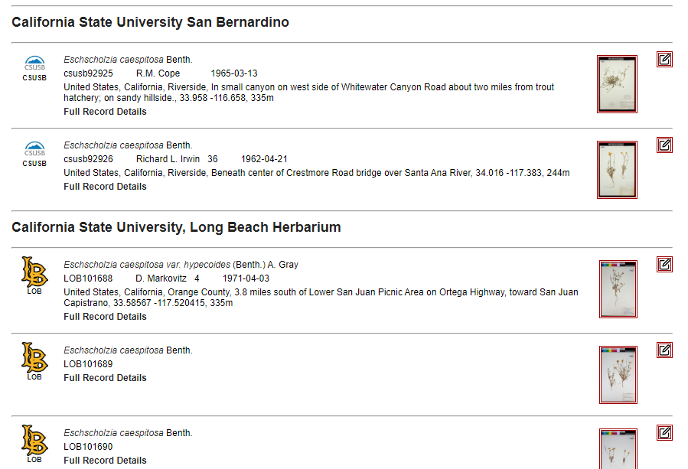
Implementation
Notes:
Users can find data on herbarium specimens from over 40 herbaria, all in one central location. For many specimen records, the user can view images and read about where, when, and by whom the specimens were collected.

Slide 22
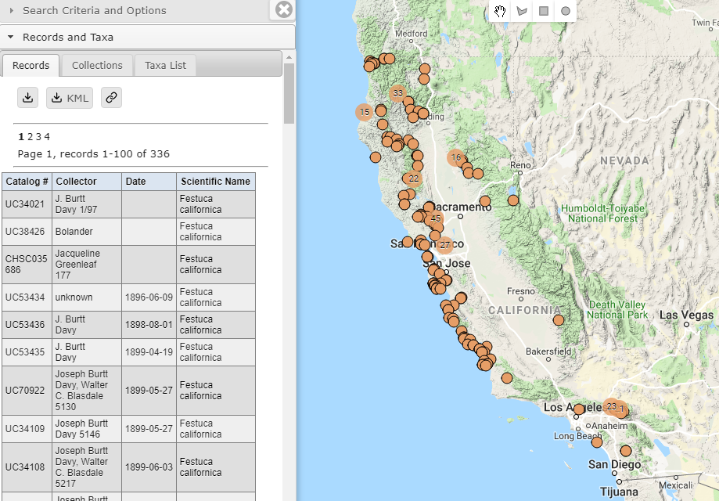
Implementation
Notes:
CCH2 can also be used to produce maps and checklists of plant taxa.

Slide 23
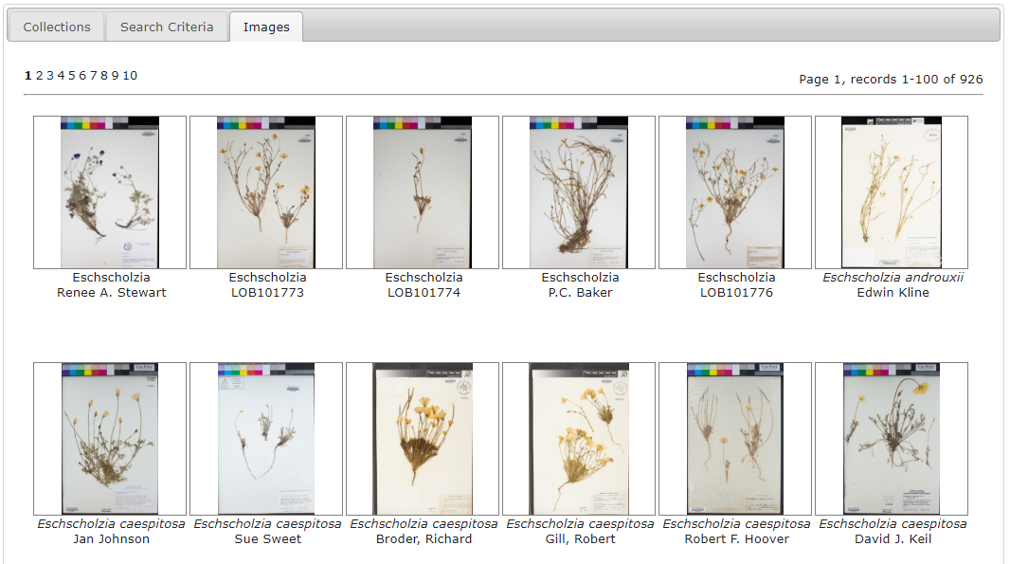
Implementation
Notes:
It can also be used to view hundreds of specimen images side-by-side.

Slide 24
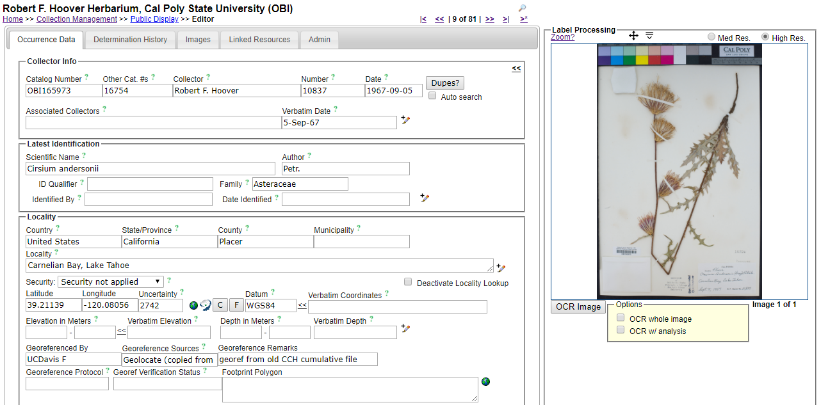
Implementation
Notes:
CCH2 is also a database management software that makes data entry easy for us. Our databasers can enter data in a browser online from the images of the herbarium specimens.

Slide 25
Implementation
Yost et al. Madroño. In press
Notes:
Before we can create these rich data products, however, we need to do the legwork to get the data into the portal. Hundreds of people are involved in making these things happen across the state.

Slide 26
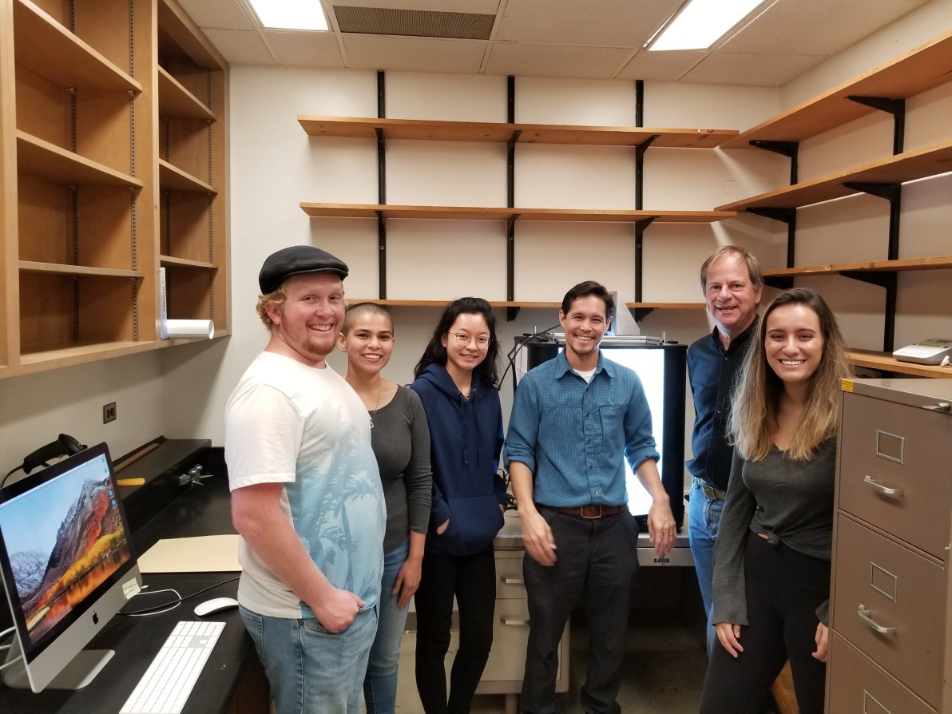
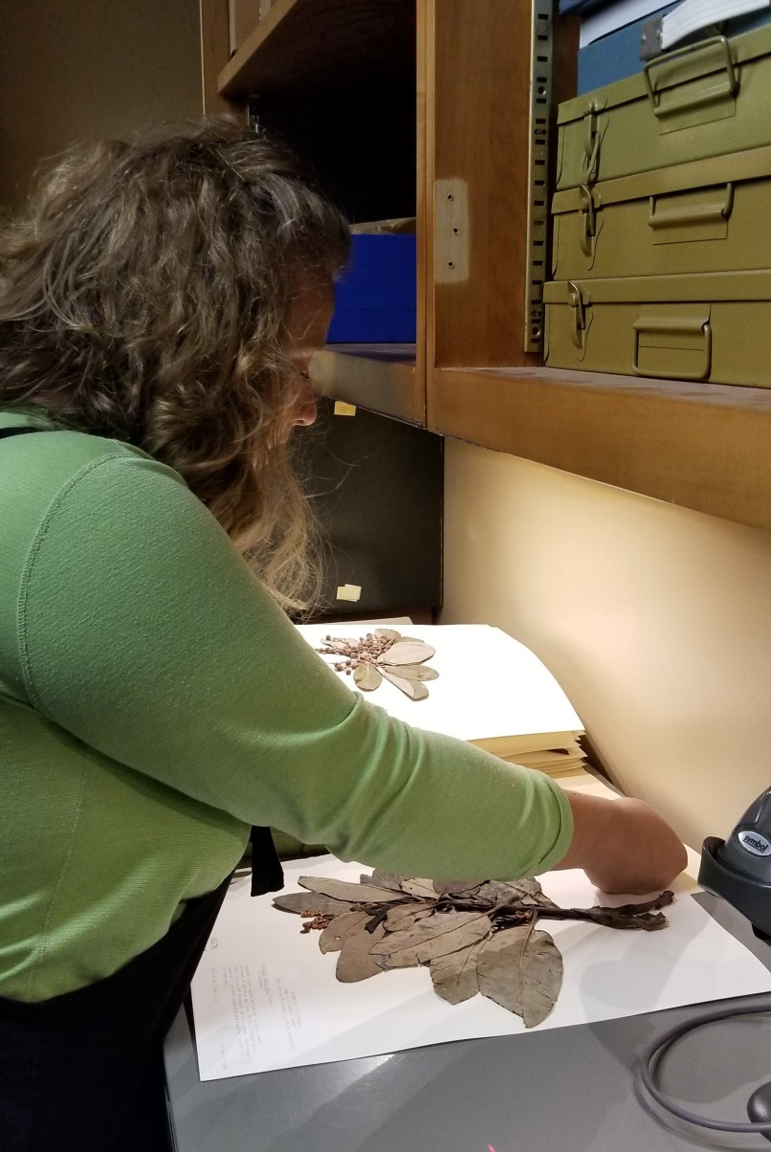
Implementation
Photo: Katie Pearson
Photo: Katie Pearson
Notes:
Which is where you come in!

Slide 27
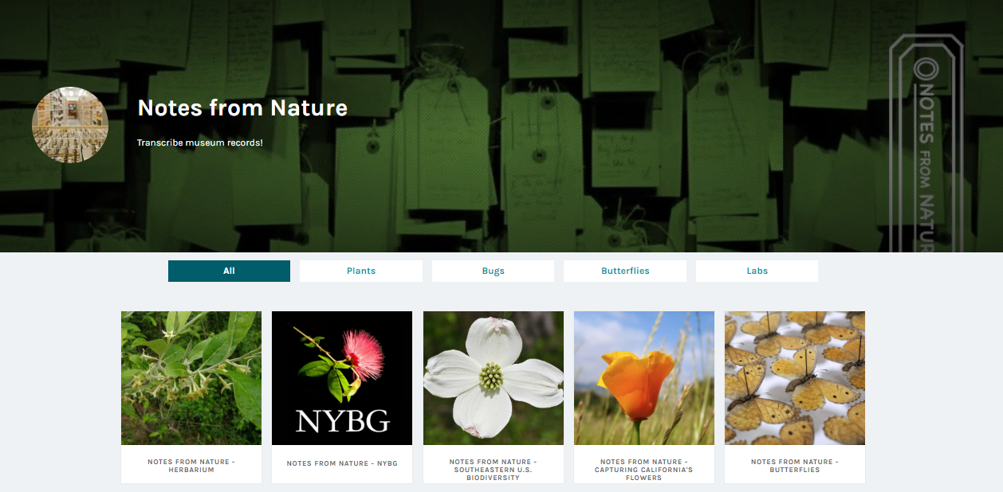
Implementation
NotesFromNature.org
That’s us!
Notes:
We’re also getting help from the broader community through Notes from Nature, an online citizen science platform where anybody can log in...

Slide 28
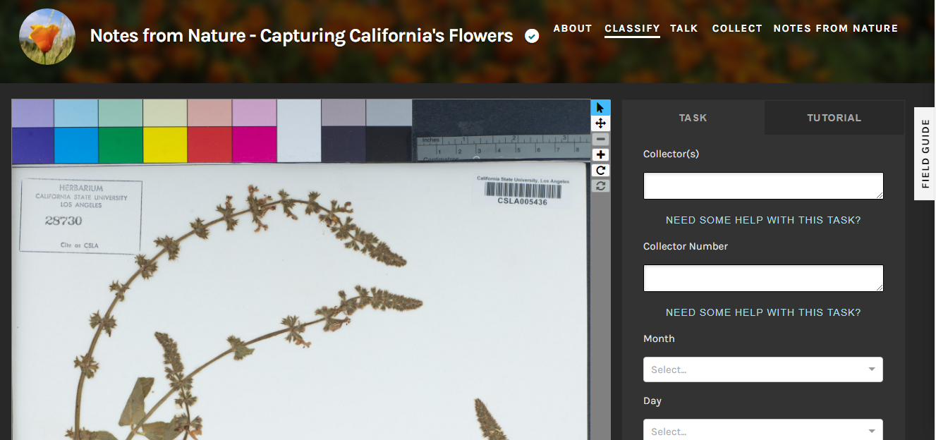
Implementation
NotesFromNature.org
Notes:
...and volunteer to transcribe data about our specimens from the high resolution images that we are creating.

Slide 29
Results
Yost et al. Madroño. In press
Notes:
The end goal of all these efforts is to produce data for scientific inquiry and to involve the public in learning about natural history, plants, and climate change, among many other topics.

Slide 30
Driving Research
Results
Which species are in the most danger of phenological mismatches?
Which habitats and vegetation types are most phenologically sensitive to climate change?
Do evergreen vs. deciduous taxa differ in their phenological responses to climate change?
Notes:
(Feel free to replace these slides with questions you think are most relevant/interesting to your group). With the data collected from this project, we will be able to better answer questions specific to phenology such as...

Slide 31
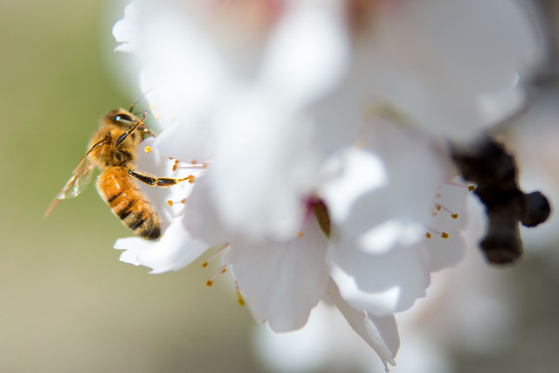
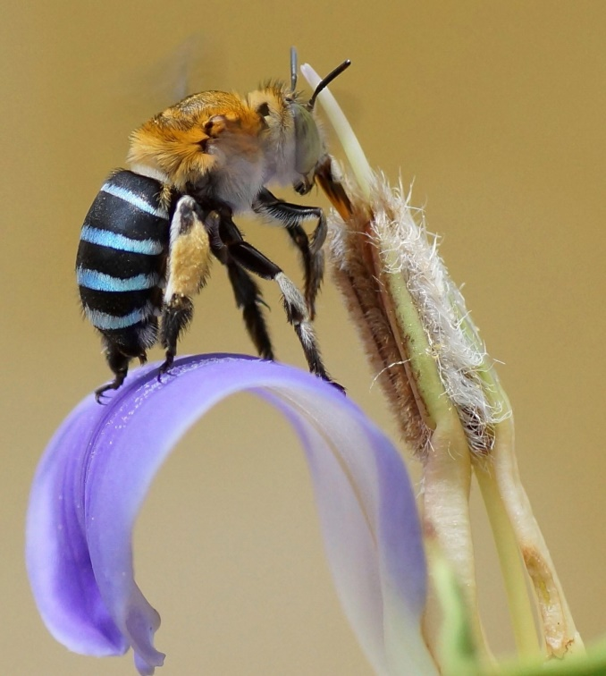
Driving Research (cont’d)
Results
Where might mismatches occur between flowering plants and their pollinators, pathogens, and pests?
Are specialist pollinators in higher danger of climate change effects than are generalist pollinators?
USDA
Chiswick Chap

Slide 32
Results
Phenology
Time
Morphology
Geography
Notes:
Every digitized specimen provides a wealth of geographical, morphological, phenological, and temporal data just waiting to be analyzed and harvested. What will we discover next?

Slide 33
Stay Tuned!
capturingcaliforniasflowers.org | cch2.org
@CalPhenologyTCN
Jenn Yost: jyost@calpoly.edu
Katie Pearson: kdpearso@calpoly.edu
This project made possible by National Science Foundation Award 1802312. Any opinions, findings, and conclusions or recommendations expressed in this material are those of the author(s) and do not necessarily reflect the views of the National Science Foundation.

